Slide 2
Patrick Cahill, CRPC®, RICP®
Head of Strategic Accounts
pcahill@Coventry.com

Slide 3
Who We Are
Coventry created the secondary market for life insurance in 1998 and has remained the industry’s largest buyer since the market’s inception. We operate across multiple business lines and, together with our affiliates, currently purchase more than 40% of all policies⁽¹⁾ transacted on the secondary market. As the only licensed provider with origins in the life insurance industry, we fully appreciate the intricacies of the life insurance industry. Our knowledge and proprietary data allows us to consistently purchase policies that others would decline.
No. 1
$400B
17,000+
Buyer of life insurance policies
Death benefit reviewed.
Life insurance policies purchased.
(1) Source: “The Life Settlement Report” by The Deal.

Slide 4
Term Insurance Opportunities
Increasing Longevity Risk
Policyowners are learning that their term life policies have value and can be sold on the secondary market.
Seniors are outliving their financial plans and are increasingly looking for new opportunities.
Industry Tailwinds
Poor Policy Performance
Evolving Estate Tax Laws
Life insurance is unique in that it is designed both as a vehicle for protection and as an investment. Because of that, policies need to be evaluated as part of an investment portfolio, separating out the need for insurance coverage from the economic returns generated by the policy.
Underperforming policies lead to dissatisfied policyowners seeking alternatives.
As estate tax laws continue to evolve, seniors are looking to rebalance their investment strategies.
Segment Growth
Awareness of Life Settlements
Approximately 10,000 baby boomers reach retirement age each day.
As seniors become more aware of the life settlement option, they’re actively seeking new information.

Slide 5
Life Settlements
A life settlement offers policyowners an opportunity to sell their policy for significantly more than the cash value offered by the insurance carrier. Simply stated, a life settlement is the sale of an existing life insurance policy for more than the policy’s cash value but less than the death benefit. The purchaser assumes ongoing premium payments and receives the death benefit upon the death of the insured. In most cases, the seller can choose to retain a portion fo the policy’s death benefit in lieu of, or in addition to, a cash payment.
Age 65 or Older
$100,000+
Change in Health
Younger insureds may qualify if other factors are met.
Most types of life insurance qualify––even term!
A decline in health may improve eligibility in some cases.

Slide 6
Term Conversion
Policy Type:
Policy Size:
Insured:
Cash Value:
Term Life
$5,000,000
Male, Age 70
$0
As the term conversion deadline approached, the policyowner was considering lapsing the policy for nothing. His advisor recommended that Coventry evaluate the policy for a life settlement.
Coventry paid the policyowner $150,000 for a policy that otherwise had no cash value. The policyowner used the proceeds to supplement retirement income. The advisor did not take a life settlement commission. The advisor converted the term policy to a Universal Life policy with a first-year target of $152,000.

Slide 7
Retained Death Benefit
Policy Type:
Policy Size:
Insured:
Cash Value:
Universal Life
$1,800,000
Male, Age 72
$23,600
The policyowner still needed some insurance coverage but wanted to eliminate his ongoing premiums.
Coventry enabled the policyowner to retain $300,000 of coverage with no future premium obligations. The policyowner achieved his goal of maintaining coverage with no ongoing premiums. The advisor received a $50,000 commission from the life settlement transaction.

Slide 8
Estate Planning
Policy Type:
Policy Size:
Insured:
Cash Value:
Universal Life
$3,800,000
Male, Age 77
$0
The grantor established an ILIT to purchase a policy to offset the grantor’s estate tax liability. When the tax law changed and the estate tax exemption was increased, the policy became unnecessary.
Coventry paid the trust $893,000 for a policy with zero cash value. The trust used the proceeds to fund the education of the grantor’s grandchildren. The advisor received a $180,000 commission on the life settlement transaction.

Slide 9
Education & Due Diligence
We have a broad range of educational programs and materials to help financial professionals understand the secondary market for life insurance and present opportunities to their clients. We host webinars, provide guest speakers, and publish print materials. Through our Life Insurance Settlement Center for Education, we are certified to provide CE credits, CLE credits, CPE credits and CFP credits in all 50 states.
CE, CFP, CPE, and CLE Education Forums
Trust Officers & Departments
Local CPA and Estate Planning Councils
Employee Benefit Specialists
Study Groups
Corporate Human Resources Contacts

Slide 10
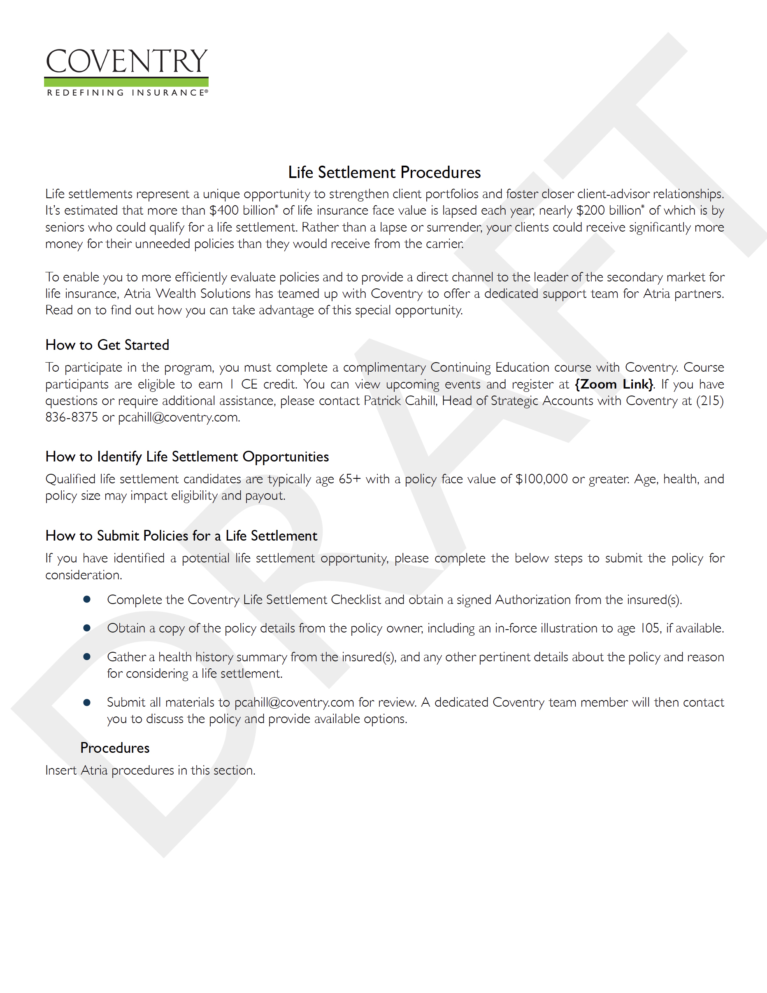
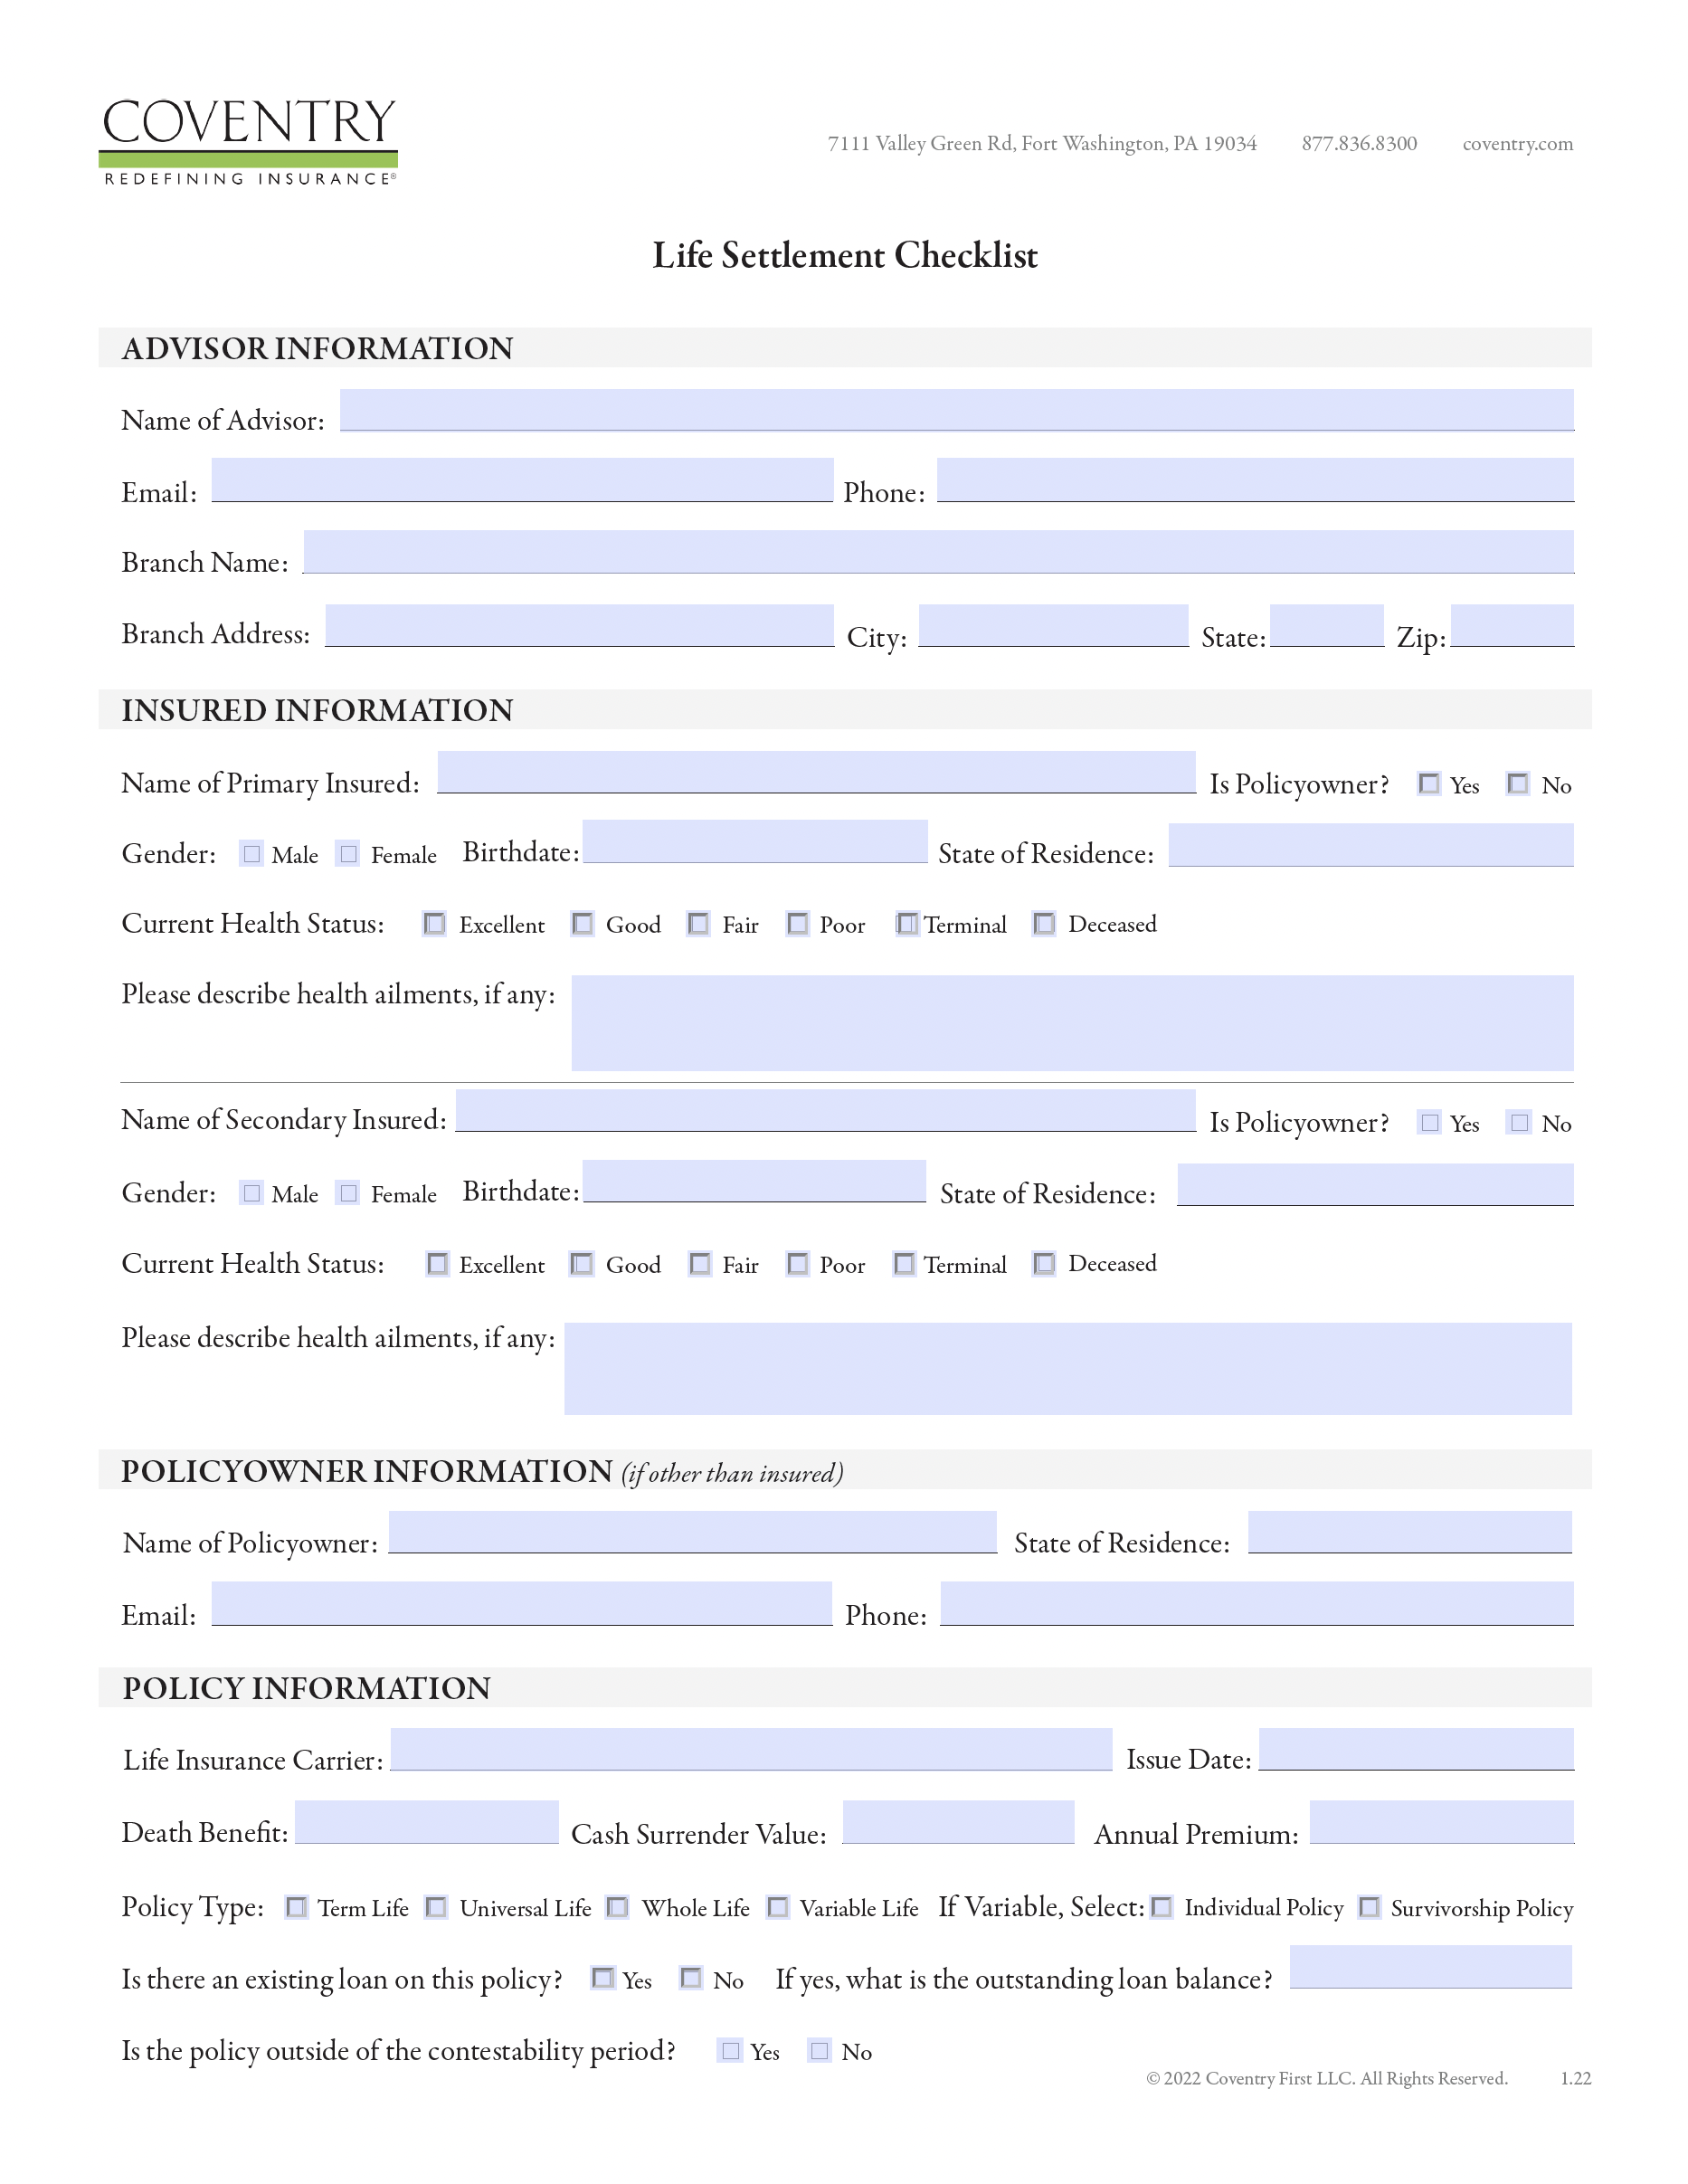
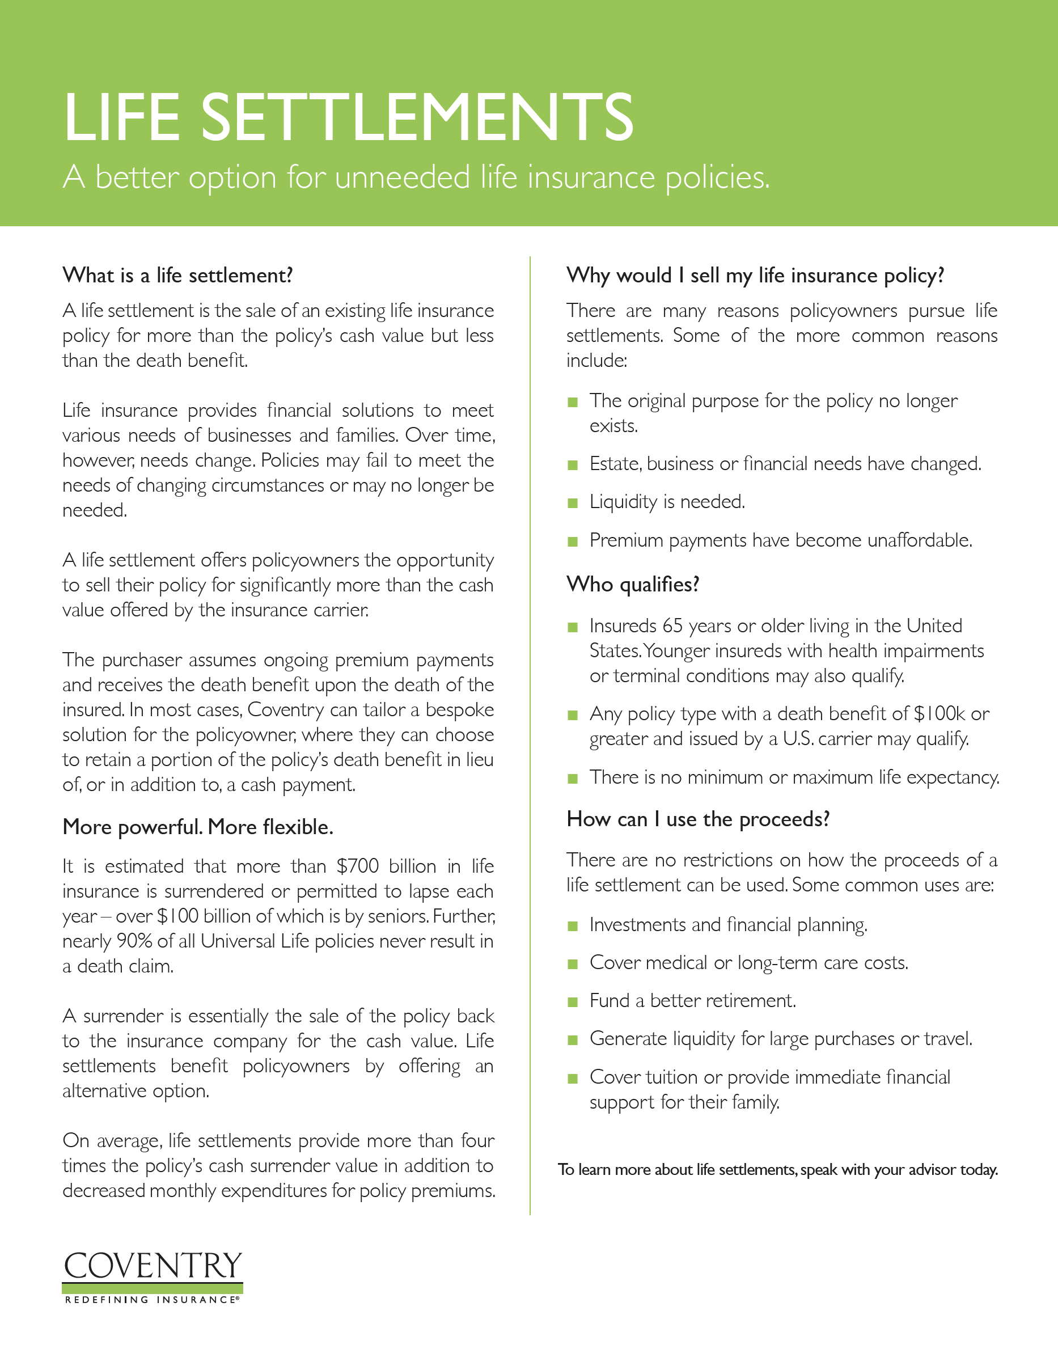
Deliverables
Coventry offers a comprehensive suite of customized marketing materials, guides, and reporting options to help you promote life settlements and keep you informed of exactly where your active opportunities are in the pipeline.

Slide 11
Reporting
Coventry provides customized reporting tools for advisors to track and manage cases. You will also have a direct line of communication with your dedicated Regional Director team who will work with you from start to finish and provide additional case information as requested.
Detailed Reporting
On-Demand Access
Total Customization
Including stage and other relevant information at the individual case level.
Comprehensive on-demand assistance provided by your dedicated Regional Director support team.
Everything we do is customizable to meet the needs of advisors and their clients.

