Slide 1
Don’t be Scared of Long Term Care
Cindy Harris
810-623-8722 charris@yourlifesecure.com

Slide 2
Plan Choices and Issue Ages
In SD: The $50,000 and $100,000 Benefit Banks are not available. A $150,000 Benefit Bank is available.
In WI.
Issue Ages: 18 – 69 Guaranteed Renewable for Life
Notes:
All on Lifetime pay – no longer offer a 10-pay option
Note – in WI the $50K BB is NOT available

Slide 3
Long Term Care Premium Examples

Slide 4
Employer Eligibility
Minimum Group Size: 10 Eligible Employees
Simplified Issue Underwriting
For ALL groups, minimum number of submitted applications = 10*
Groups with 10–99 eligible employees: Employer contribution is required
Groups with 100+ eligible employees: Offering may be voluntary
Full Underwriting
Minimum number of submitted applications = 5*
Offering may be voluntary – no employer contribution requirement
* Application count includes spouses/partners
Notes:
10 submitted apps still includes EE and SP apps
For ER Contribution, now only offer the Defined Plan Design or Defined Dollar amount (no longer percentages)

Slide 5
Discounts
Spouse Discount
10% discount when both spouses/partners apply for coverage at the same time
Employer Contribution Discount
5% discount when employer contributes to the premium
Notes:
EE/SP have to apply within 10 days of each other to receive the discount – otherwise NO discount.

Slide 6
Benefit Payout Structure
Expense Reimbursement for qualified long term care services up to full Monthly Benefit
Home Care (home care agency or independent providers)
Assisted Living Facility
Adult Day Care
Nursing Home
Hospice
OR
Cash Alternative Monthly Benefit – calculated at 30% of Monthly Benefit
Can be used to pay informal caregivers, such as a family member or friend, or for any other purposes unique to the claimant’s care situation
Claimant can choose approach on a monthly basis.
Notes:
Have to use EITHER the Expense Reimbursement for licensed care OR the Cash Alternative in a given month – can no longer use both like the Flexible Benefit on 2.0.

Slide 7
Other Standard Features
Home Modification and Supplemental Products Benefit
Coverage for services and products that may be required for the claimant to live more securely and independently at home
Covered expenses reimbursable up to 1 X Monthly Benefit over the life of the policy
Examples of services and products that are eligible for reimbursement:
Home Modifications – equipping one’s home for greater safety or access related to long term care impairment, such as building or installing an access ramp, widening doorways, installing grab bars in the bathroom
Assistive Devices or Technology – adaptive tools, devices or technology that helps one function independently at home, such as specially-adaptive eating or dressing devices, emergency medical response systems, or other technology devices used to monitor movement and personal safety at home.
Durable Medical Equipment – medical equipment that one buys or rents and is designed to assist one in living at home, such as walkers, hospital-style beds, crutches and wheelchairs
Above benefit can be received in addition to other reimbursable covered expenses or the cash alternative in a given month.

Slide 8
Additional Standard Features
Benefit Wait Period
90 Calendar Days
Becomes 0-Day if claimant’s qualifying condition is triggered suddenly by an Accidental Injury or Stroke
Waiver of Premium
Premiums waived beginning on the first day one starts receiving benefits

Slide 9
Optional Benefits
Compound Inflation Benefit Rider
Choice of 1%, 3% or 5%, allowing one’s current Monthly Benefit and remaining Benefit Bank to automatically increase by chosen percentage each year
Nonforfeiture Benefit Rider
Allows a reduced paid-up benefit amount if one lapses coverage after it is inforce for at least three full years
Notes:
1% is Partnership approved in: AZ, ID, KS, LA, MN, MI, NE, NV, OK, ND, WV and CO at this time. Waiting for approval in some other states.

Slide 10
Underwriting Parameters
Simplified Issue Underwriting
Eligible Employees ages 18 to 64 during open enrollment period (and new hire window)
Actively-at-work Spouses ages 18 to 49 during open enrollment period (and new hire window)
Additional Underwriting
Eligible Employees ages 65 to 69 – all time periods
Eligible Employees ages 18 to 64 outside of open enrollment period (or new hire window)
Actively-at-work Spouses ages 18 to 49 outside of open enrollment period (or new hire window)
Actively-at-work Spouses 50 to 69 – all time periods
Spouses not actively-at-work, all ages – all time periods
[ Refer also to more detailed Underwriting Protocols grid. ]
Notes:
No longer require a census with NEW LTC3 groups or AAW documentation (i.e. paycheck stub)
“Eligible EE” is defined by the Employer so we don’t ask if W2, 1099, etc….if Eligible EE and on List Bill it is the responsibility of the Employer to pay the bill and get the necessary payroll deduction if need be.

Slide 11
LifeSecure’s LTC Competitive Hot Points
① Four Easy, Straightforward Plan Choices
② New 1% Compound Inflation Rider, allowing for a more affordable qualifying Partnership plan
③ Cash Alternative Monthly Benefit, allowing ultimate flexibility to the individual at time of claim
④ Waiver of Benefit Wait Period (i.e., 0-Day) when impairment triggered suddenly due to an Accidental Injury or Stroke
⑤ Home Modifications and Supplemental Products Benefit
⑥ Simplified Issue Underwriting
⑦ 5% Employer Contribution Discount
⑧ Fast Underwriting; Fast Issue within 5 business days
⑨ Fast Commissions Payments (weekly!)
⑩ Self-serve or Agent-supported On-line Enrollment

Slide 12
ABC’s of Selling… is it???
Always Be Closing
OR
Always Bring Choices
Remember this….
It is unethical to sell someone a product they don’t need. It is also unethical to Not sell someone a product they do need.
By: Jody Williamson

Slide 13
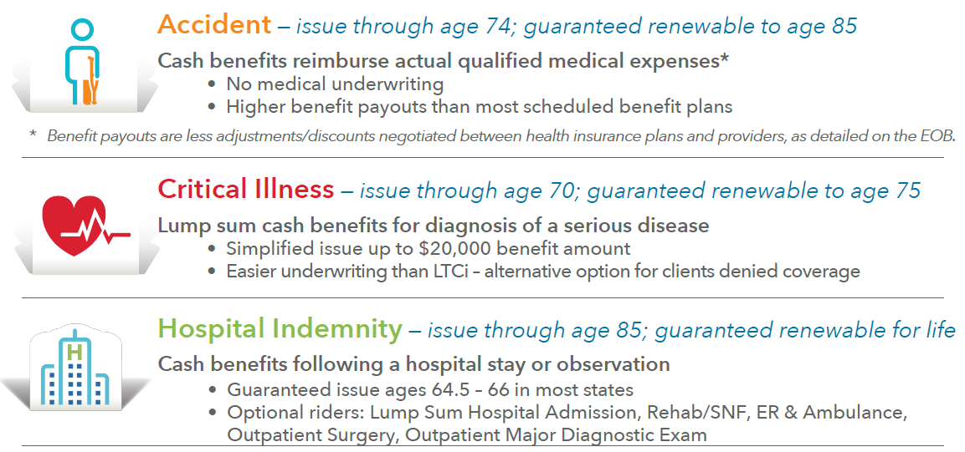
LifeSecure’s Ancillary Health Benefits

Slide 14
Marketing Resources
LTC Data Gathering Sheet
Product Build Chart
LifeSecure Employer Brochure
Consumer Postcard Example
Consumer Flyer Example

