Slide 2
Welcome New Members!

Slide 3
Top Referring Members

Slide 4
Financial Security Advocate
Members can earn NAIFA’s Financial Security Advocate badge online and through quarterly webinars.
Proudly display your FSA Badge on your LinkedIn profile.

Slide 5
[Insert State] FSA Badge Holders

Slide 6
NAIFA’s IFAPAC
50 State PACs and Federal PAC ensures that NAIFA has a seat at the table with state and federal legislators and regulators.
A strong IFAPAC is insurance for your business career.
Visit the IFAPAC booth to learn more!

Slide 7
NAIFA’s Triangle Team
All of NAIFA Nation’s Triangle Team Members are proudly listed in our NAIFA Member Portal.

Slide 8
California Triangle Team Members

Slide 10
California New LILI Grads

Slide 11
Are You All In?
Our agencies and firms that support NAIFA are proudly displayed to consumers at financialsecurity.org.

Slide 12
[Insert State] 100% Agencies & Financial Security Champions
[Insert logos of firms/ agencies in your state]

Slide 13
Key Signature Events Where You Can Represent [Your state]

Slide 14
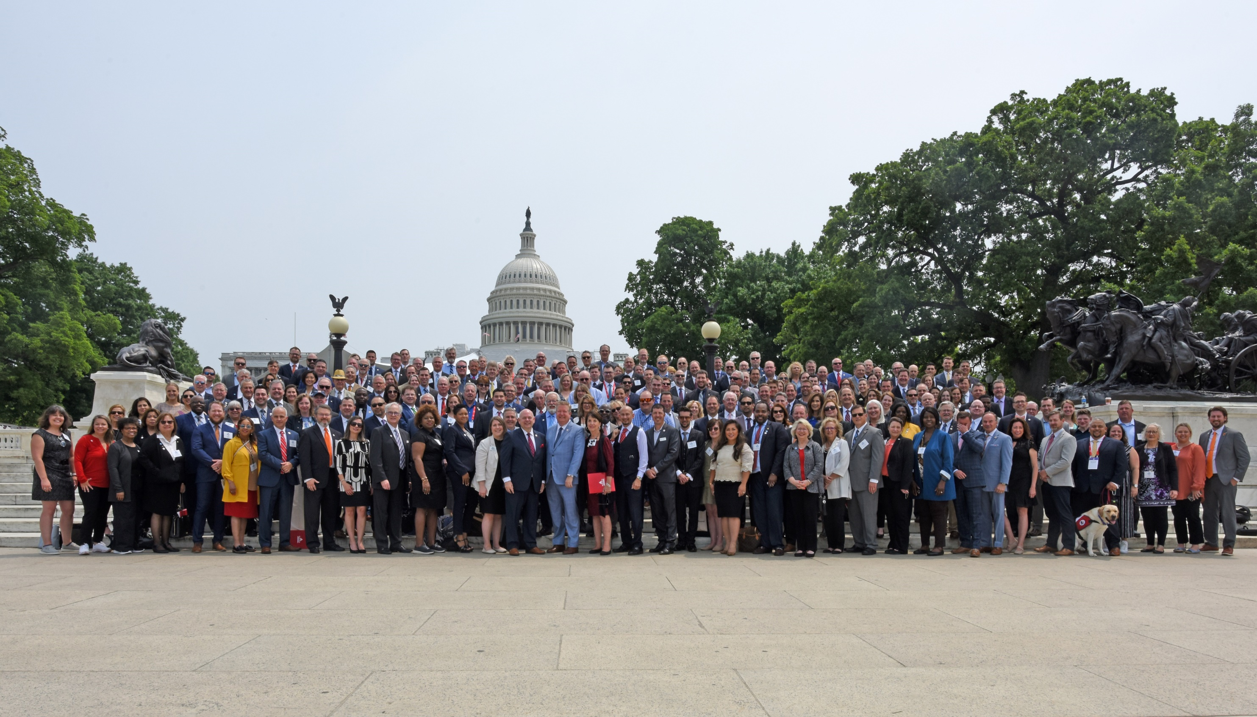
Congressional Conference Washington, D.C.
May 20-21, 2024
WE ARE THE PEOPLE.

Slide 15
Insert apex 2024
Arizona Biltmore
September 19-21, 2024

Slide 16
Key Member Benefits

Slide 17
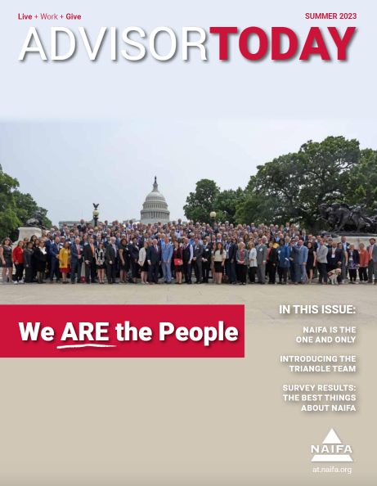
Advisor Today
Printed magazine
Star in a podcast
Write for Advisor Today

Slide 18
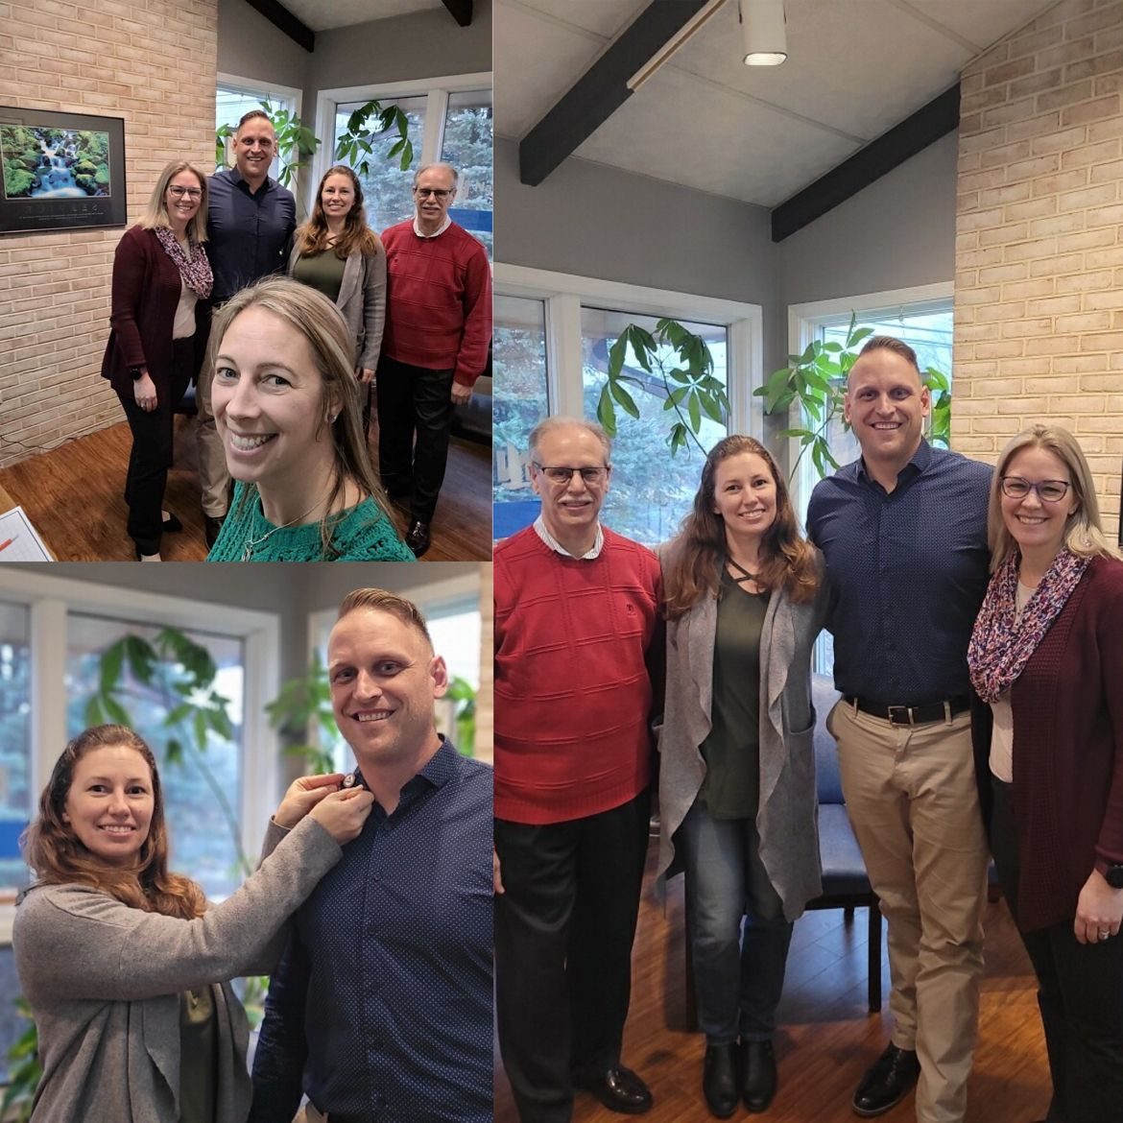
ONE NAIFA
NAIFA Live is your monthly opportunity to gain insight and advice on how to excel in the industry from the best in NAIFA Nation. Tune in online or join a local watch party!
NAIFA-Pennsylvania's watch party from a previous NAIFA Live.

Slide 19
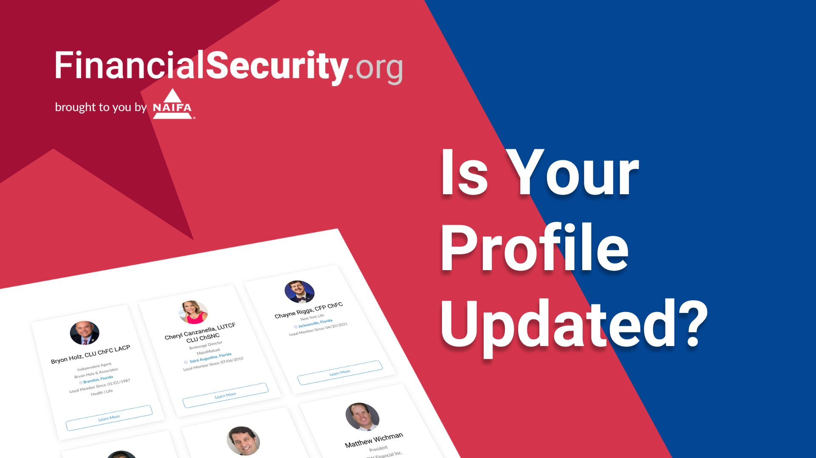

Slide 20
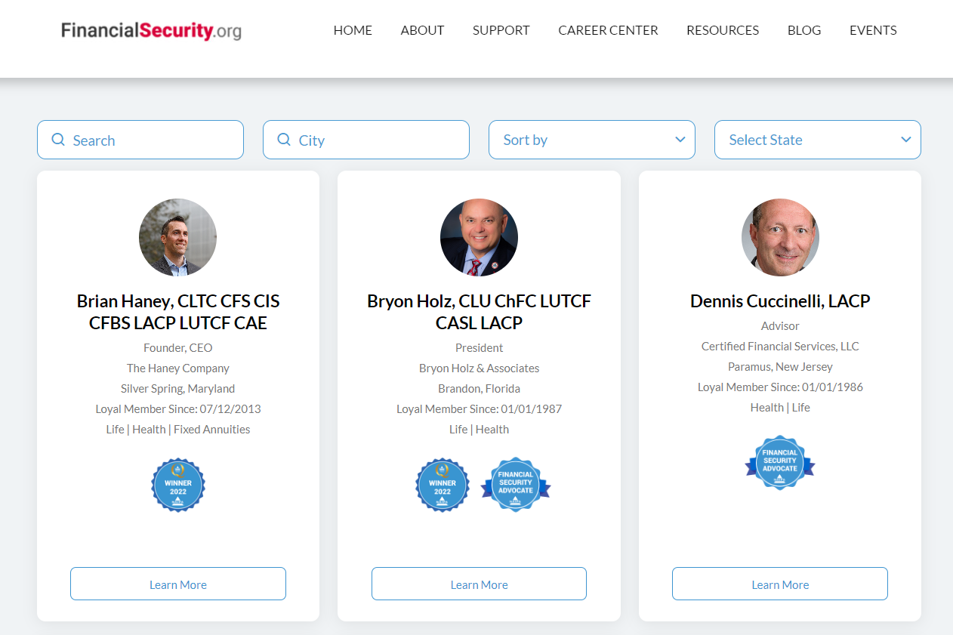
Find an Advisor
Every member has a free profile that consumers use to find an advisor.
Update your profile on NAIFAConnect!

Slide 21
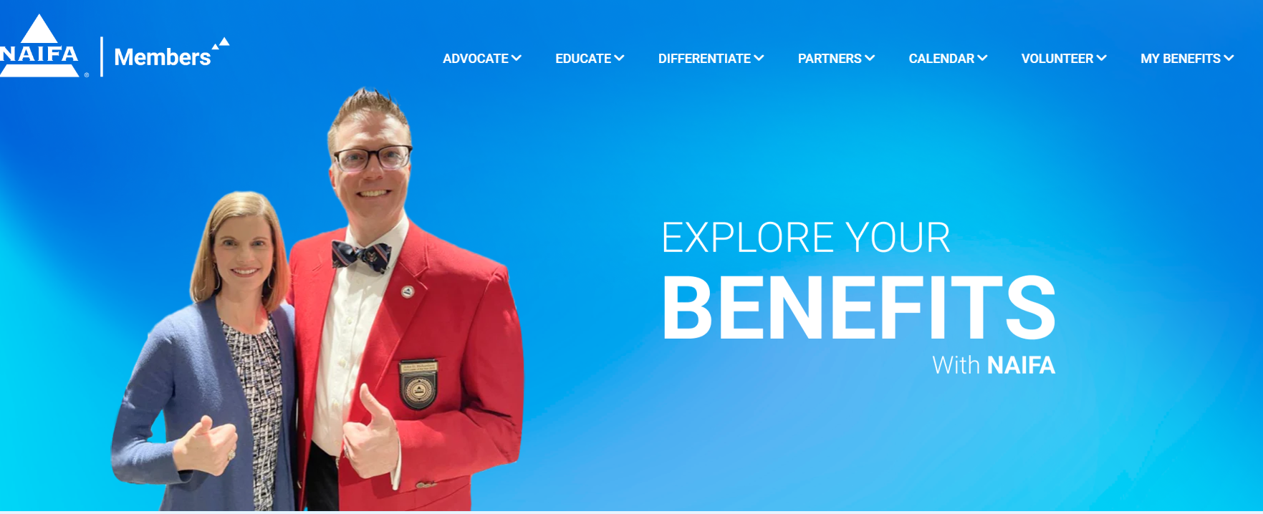

Slide 22
